Slide 1

COVID-19 Dashboard
Final project
CEBD-1261
Yevseyenko Olga

Slide 2

Why this project?
Relevant topic
Good case study of applying what was learnt in a class
Lot of potential of data processing
Lot of potential of data visualization

Slide 3
Data sources
There are multiple data sources
Priority was for up to date and complete data
The John Hopkins University keeps an updated GitHub repository with daily data.

Slide 4
Data loading
The data was fetched using Python’s requests library.
4 files was were received: cases, deaths, recovered and demographics.
A script was created (called update_data.py) to update the data that is meant to run daily.

Slide 5
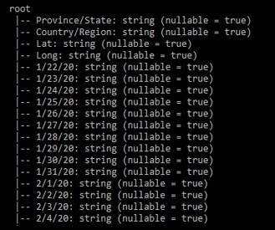
Data cleaning
The data is almost clean, but minor changes are required.
The original datasets have each new day as a separate column, with the column name being the data.
Notes:
For example, 28 February + 1 day = 1st March. Such rules have to be taken care of manually

Slide 6
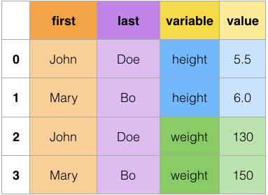
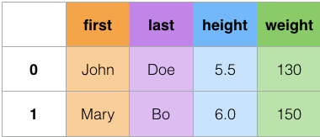
Data cleaning
The problem with this is that the dates are strings and not datetime objects, and it becomes harder to compute deltas, so
a new column was created and called date
the dataset was transformed from a wide format to a long format.
A re-implementation in pyspark of the melt function in pandas was used.

Slide 7
Data cleaning
Countries with provinces have the data of their provinces at the province level. So we aggregate the data of these countries by grouping on countries where province column is not Null, then we sum.
Each entry represents cumulative sum, which is not directly usable. A new column is created to represent the delta difference between each day and the one before (Using Spark window function).
3 datasets of cases, deaths and recoveries was joint to make a single dataset

Slide 8
Data analysis
To mitigate some of the effects of slow pyspark on my machine, I saved some of the analysis (Worldwide aggregates) as pickle files after they were calculated. This way, the dashboard reads the data directly.
For the country level, Spark calculates the needed data for the graphs, and then we plot the data by converting the data to pandas then we plot using matplotlib.
Notes:
Pickle file is a compressed file of pyton object.

Slide 9
Dashboard
Made using a library called Streamlit
Made of two pages:
World
Aggregates some key statistics about the status worldwide
Specific Country
Makes 3 plots.
The X-axis is the time
y-axi:
Plot 1: Daily new cases
Plot 2: Daily new deaths
Plot 3: Daily new recoveries
Notes:
Steamlit is a pyton library that creates the dashboards as webserver

Slide 10

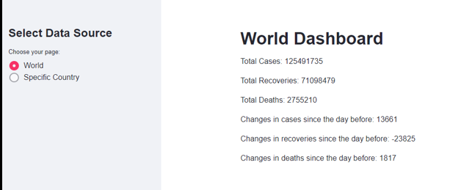
Dashboard

Slide 11
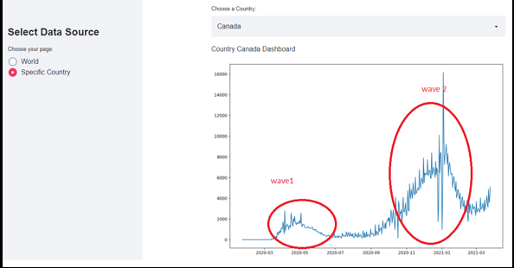
Dashboard

Slide 12

Challenges
Data loading pitfall: Fetching directly data from GitHub returns HTML components as well. When you want to programmatically fetch some new data, use raw.github.com as the domain, and remove “blob” from the URL.
Data cleaning: Making pyspark work was hard. It did not work with Python 3.8 and had to make a new environment with older python to make it work.
Data analysis: Because pyspark was slow on my computer, I reduced the number of analysis to make the dashboard usable, otherwise it takes too much time.
Future work:
Add demographics data to the analytics, so that we can calculate the percentage of population affected.
Finish airflow DAGs of the project, and schedule daily data update and collection.

